Slide 1
Data Mining Project Presentation
Ryan Patton
Health and Usage Monitoring Systems (HUMS) in Aerospace Industry- Turbofan Engine Degradation

Slide 2
What is HUMS? Why Focus on this?
HUMS is a generic term given to activities that utilize data collection and analysis techniques to help ensure availability, reliability, and safety of vehicles, prominently used in the aerospace industry.
HUMS Uses
Safety – avoiding catastrophic failures
Cost – maintenance helps aircrafts’ longevity. By performing repairs when damage is minor, the mean time between failure (MTBF) is increased and the mean time to repair (MTTR) is decreased
Operational – improved flight safety, mission reliability and effectiveness
Performance – improved aircraft performance and reduced fuel consumption
“Hot” area in aerospace research due to its practicality, emphasis on safety, and lucrative promises
Computing power and aircraft monitoring tools now readily available for real-time data transmission monitoring
Aircrafts are worth billions of dollars – minor HUMS improvements can save lots of money
Difficult creating commercial HUMS solutions. Aircraft data is mostly proprietary information, if not classified
Finding data was difficult for this topic

Slide 3
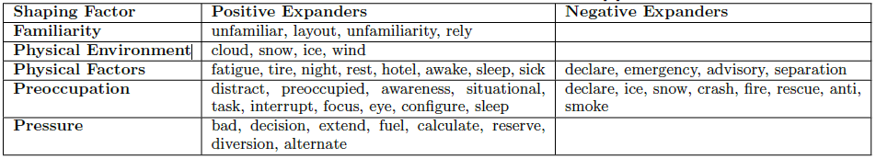
Data Mining Methods in Aerospace Industry
Data Mining Flight Recording Data Using Multiple Kernel Learning
Data Mining Flight Recorder Data using Hidden Markov Models and Hidden Semi-Markov Models
Data Mining Aviation Incident Reports

Slide 4
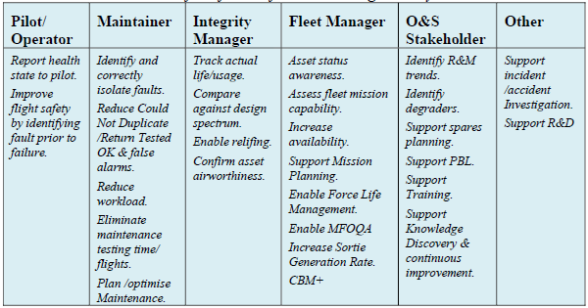
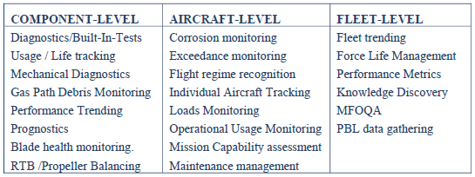
Applications

Slide 5
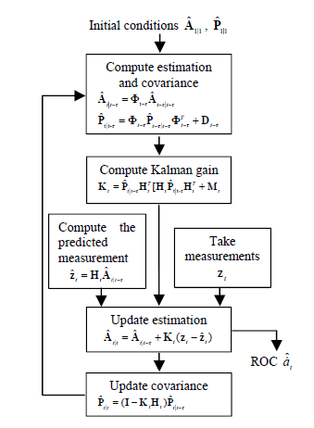
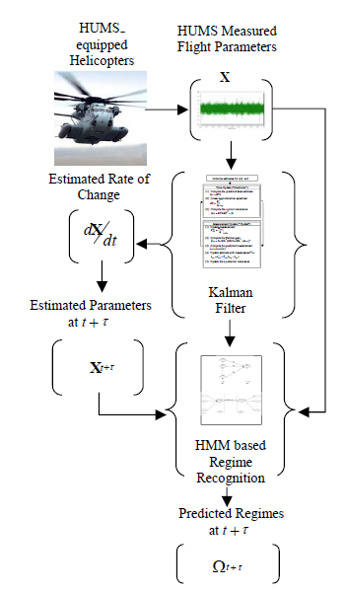
Example: UHL-60 (Blackhawk) Prediction Approach – HUMS Applications
HUMS has the most immediate applications in the aerospace industry with rotorcrafts.

Slide 6

Sikorsky S-92 Leading the Way

Slide 7
Data Collection Efforts/Sample Data
Sources of data considered
turbofan engine degradation (winner)
prognostics and health management (PHM08)
lithium-ion battery degradation
gearbox fault detection
Bearings
capacitor electrical stress
small satellite power
Turbofan engine degradation dataset used for training and testing model, PHM08 dataset contains similar data but remaining useful life (RUL) values aren’t given (will see how RUL applies shortly)
Turbofan engine degradation data
Text files
4 data sets – pre-divided into training and test
Multiple multivariate time series – each time series is from a different engine, each engine data derived from a previously used engine with unknown wear
26 columns of data: (1) unit number, (2) time, in cycles, (3)-(5) operational settings, (6)-(26) sensor measurements
Each row of data taken from a single operational cycle (1000’s of rows)

Slide 8
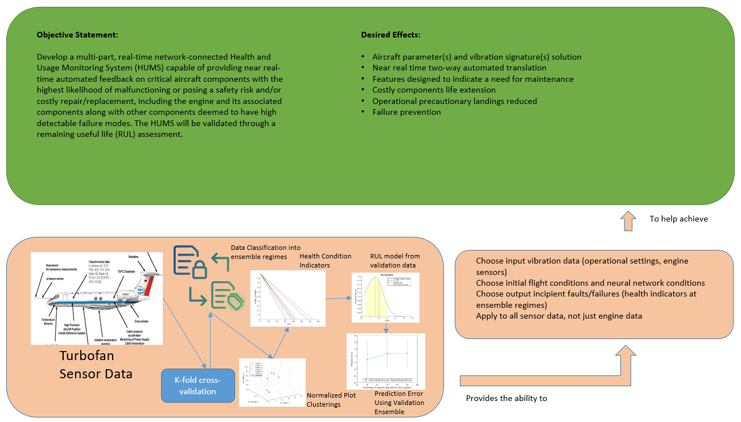
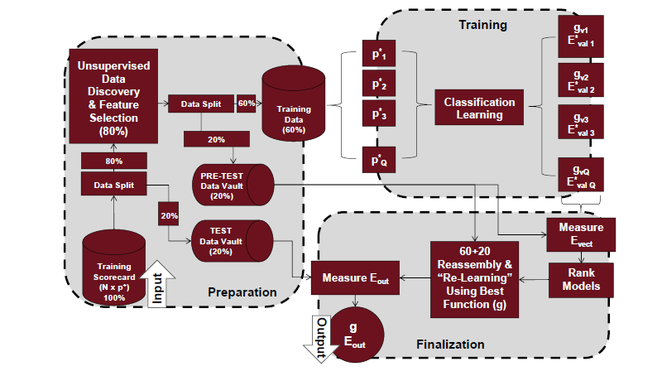
Architecture
Pictured on right: machine learning algorithm process flow for a UH-60 Blackhawk HUMS
Pictured on left: updated high-level implementation architecture

Slide 9
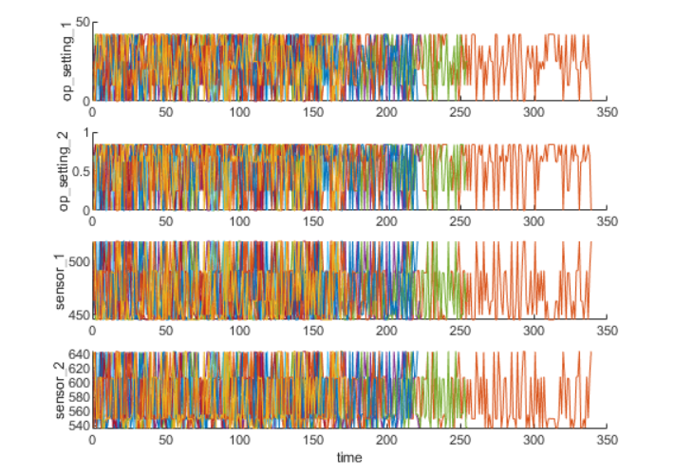
Data Pre-Processing and Post-Processing
Data was already sorted with training and test datasets
Data was converted from text files to xlsx (Excel) files
Normalized data – included standard deviation
K-fold cross-validation used to visualize samples of the ensemble data
Pictured is a sample of
what the ensemble data
should look like

Slide 10
Data Processing with Testing and Training
For the three settings, the table from each cell will be extracted and concatenated into a single table. The operating points may be seen in a 3D scatter plot with 6 regimes total showing
By using the K-means algorithm with different initial conditions, the result with the lowest cost can be picked (about 5-10 runs with different initial conditions)
Another cluster plot will be generated with K-means algorithm to find the 6 working regimes
Normalize working regimes: compute mean and standard deviation of each sensor measurement
Extract operating points of each row, compute distance to each cluster centers, and find the nearest cluster center. For each sensor measurement, subtract the mean and divide it by the standard deviation of that cluster. If it’s close to 0, set the normalized sensor measurement to 0
Visualize normalized data by working regime – should show degradation trends
Select trendable sensor measurements to construct a health indicator for prediction. A linear degradation model will be estimated and the slopes of the signals ranked, want to select 8 sensors with the largest slopes and plot

Slide 11
Neural Network Implementation
Learning rate: 0.01 or 0.001 – given the amount of data available and the number of epochs that can be run through cross-validation, a small learning rate is acceptable
Weight initialization: start off with small weight initialization values – start off with 0 to not introduce a bias off the bat. Test with different weight initializations until optimal values are found
Batch Size: start off with batch mode so the batch size is equivalent to the total dataset and will make the iteration and epoch values equivalent.
Number of Epochs: Start off with 1,000 – if it returns a quick projected run-time like as expected, bump that up to 10,000. Ideally, 100,000+, runtime shouldn’t be affected too bad. Implement in MATLB. Expect 10,000 to have a run-time less than couple minutes but unsure of Python runtime (if desired in the future)
Initial Conditions: all subjective to achieve best cost and will require some tweaking of the numbers based on observations

Slide 12
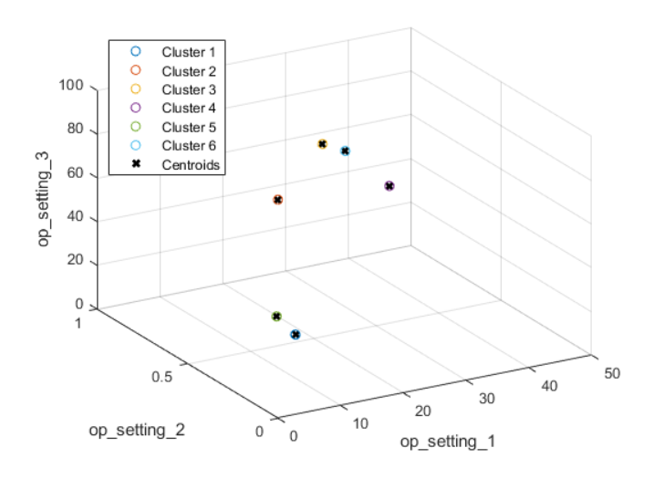
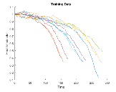
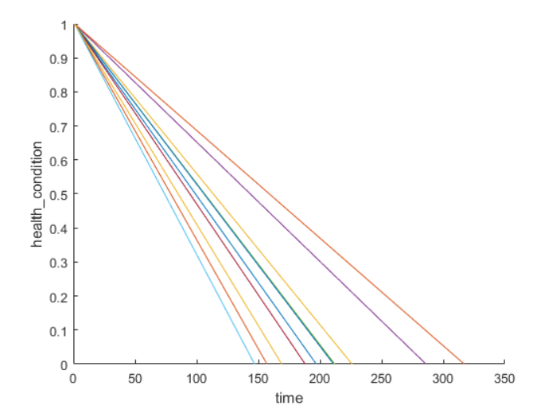
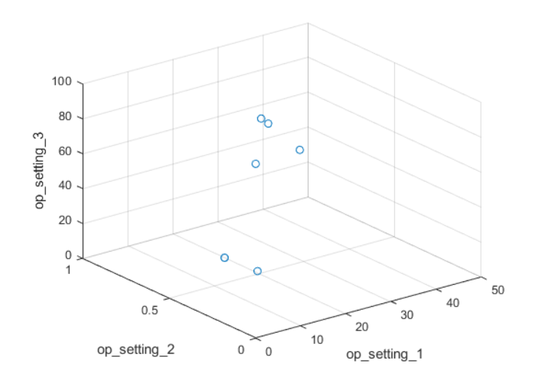
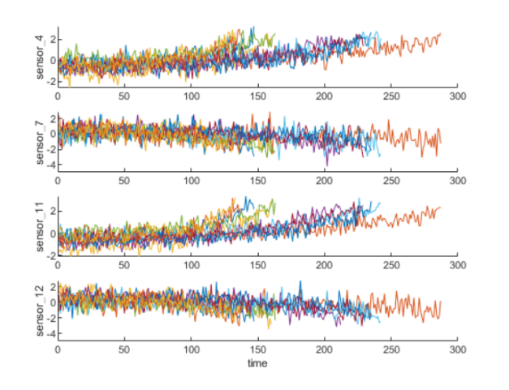
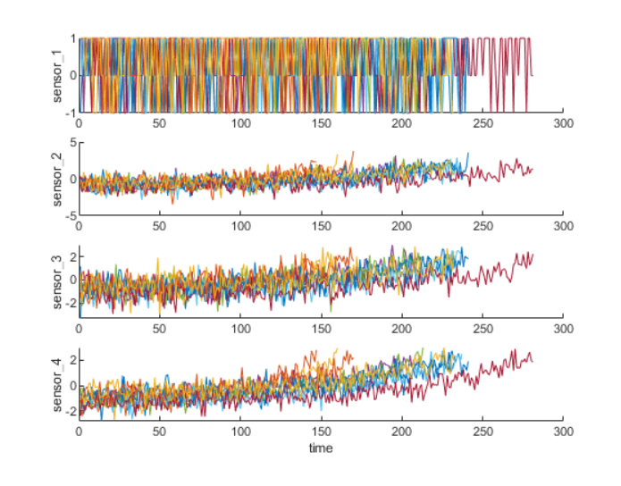
Plots
Top Left: Conditional Plot Cluster, Top Middle: Health Condition Training Data, Top Right: Normalized Health Condition
Bottom Left: Cluster Plots, Bottom Middle: Ensemble Sensor Trend Plots, Bottom Right: Normalized Ensemble Sensor Plots

Slide 13
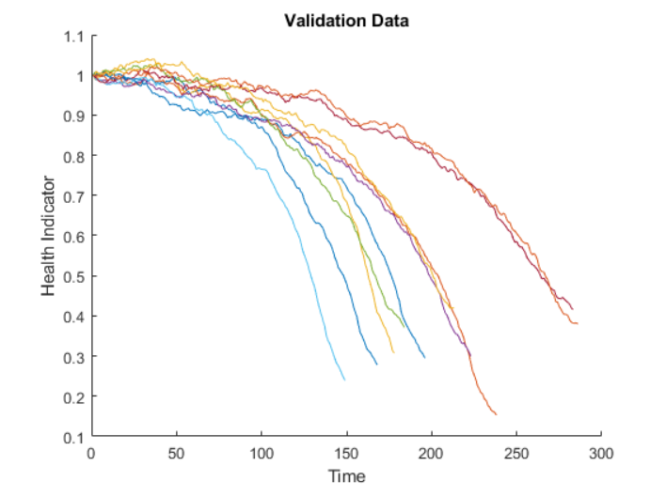
Validation
Regime normalization and sensor fusion process repeated with validation data set

Slide 14
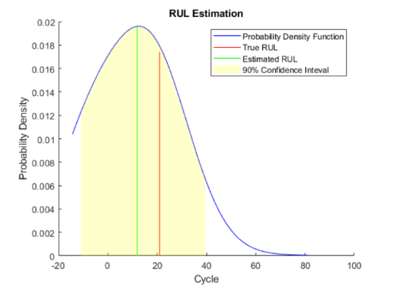
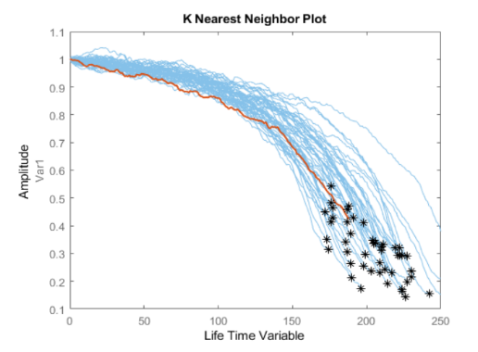
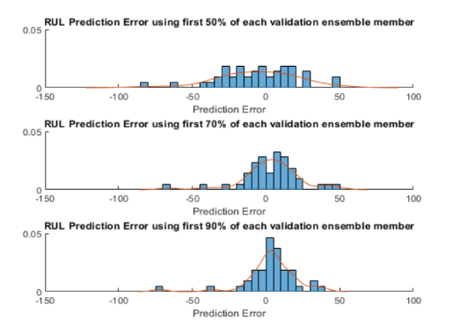
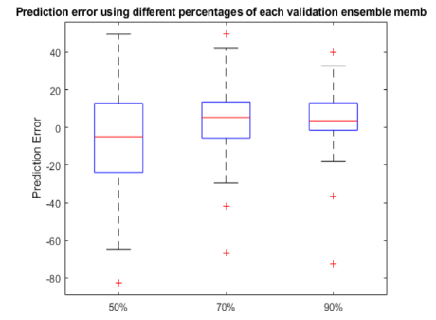
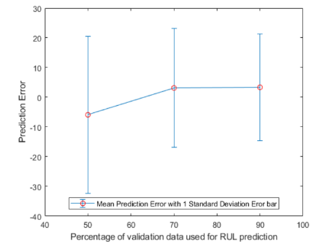
Network Performance
Create RUL model, with 50%, 70%, and 90% of sample validation data to predict its RUL
Plots for validation data truncated at 50%, 70%, and 90% and its nearest neighbors
Plots for estimated RUL compared to true RUL and the probability distribution of the estimated RUL
Repeat same evaluation procedure for the whole validation data set and compute the error between estimated RUL and true RUL for each breakpoint
Plots for prediction error
Plots for prediction error in a box plot to visualize the median, 25-75 quantile and outliers
Plot for standard deviation of the prediction error

Slide 15
Future Work/Conclusions
Participate in the PHM08 Challenge by NASA (continuation of current work)
Model with different algorithms
Atypical Flight Segment Identification with Morning Report
Inductive Health Monitoring with Clustering and Statistical Methods
Anomaly Detection with Density-Based Clustering
Anomaly Detection in Nominal Flight Data Sequences
Anomaly Detection with Multiple Kernel Function
Anomaly Detection with Nearest neighbor and Symbolic Dynamic Filtering
HUMS with Load Cycle Analysis, component failure via sensor network with engine, transmission, vibration sensors, and angular shaft speed indicators
Flight Operational Quality Assurance guidelines
Frequent Pattern Growth algorithm
Practice the same implementation of work in Python 3
Try with different datasets: with modern focus on HUMS more data may become available
Use lessons learned from neural networks and apply them to my work to train simulated flight data to match real flight condition values

Slide 16
References
[1] “residualSimilarityModel,” MATLAB & Simulink. [Online]. Available: https://www.mathworks.com/help/predmaint/ug/similarity-based-remaining-useful-life-estimation.html. [Accessed: 18-Apr-2020].
[2] D. Wade, R. Lugos, and M. Szelistowski, “(PDF) Using Machine Learning Algorithms to Improve HUMS Performance” [Online]. Available: https://www.academia.edu/26956620/Using_Machine_Learning_Algorithms_to_Improve_HUMS_Performance. [Accessed: 20-Apr-2020].
[3] J.M. Pena, F. Famili, and S. Letourneau, “Data mining to detect abnormal behavior in aerospace data,” Proceedings of the sixth ACM SIGKDD international conference on Knowledge discovery and data mining - KDD ’00, 2000.
[4] A. Saxena and K. Goebel (2008). “Turbofan Engine Degradation Simulation Data Set”, NASA Ames Prognostics Data Repository (http://ti.arc.nasa.gov/project/prognostic-data-repository), NASA Ames Research Center, Moffett Field, CA
[5] A. Saxena and K. Goebel (2008). “PHM08 Challenge Data Set”, NASA Ames Prognostics Data Repository (http://ti.arc.nasa.gov/project/prognostic-data-repository), NASA Ames Research Center, Moffett Field, CA

Slide 17
Questions?

